Slide 1



Slide 2


LIBREF
The Internet of Things (Internet of Things, IoT for short) is the communication network where physical objects are connected to each other or to larger systems. They are embedded with sensors, software and other technologies to connect and exchange data with other devices and systems over the Internet.

Slide 3


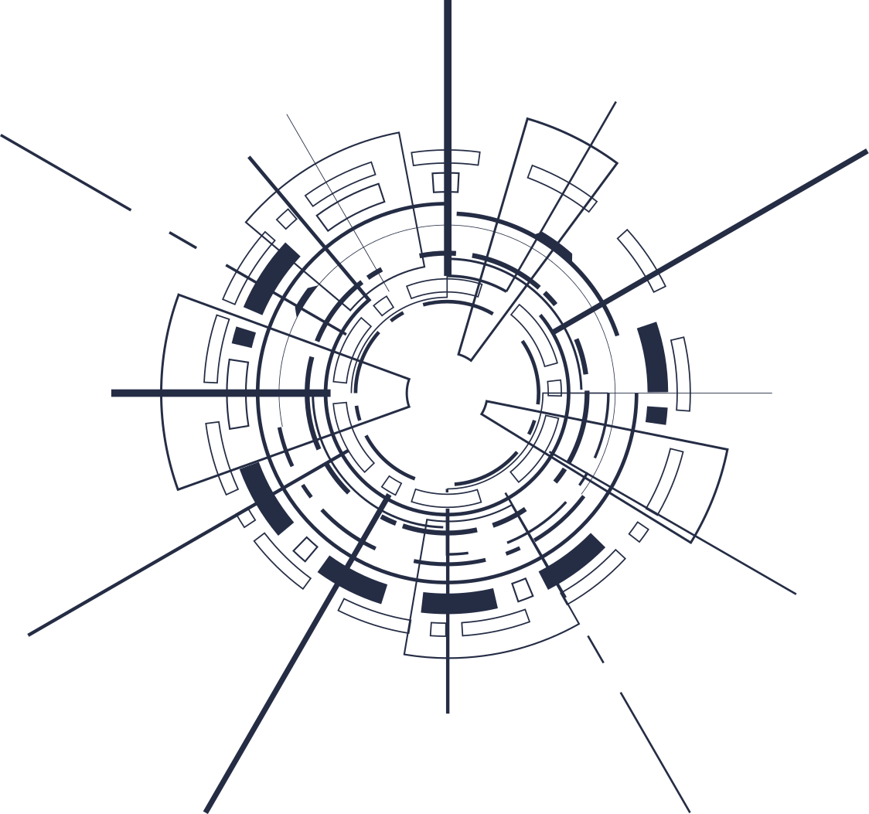

IOT & INDUSTRIES
Construction
Defense
Automotive
Library
Health
Archive
Logistics
Museum
Textile
Jewelry

Slide 4
En iyi toplantılar, işbirliğine dayalı toplantılardır! Ekip arkadaşlarınızı eklemek ve işbirliği yapmaya başlamak için "Paylaş"a tıklayın.
HF & UHF DIFFERENCES
HF
UHF
HF
UHF
OPERATING FREQUENCY RANGE
13.56 MHz (Close Reading)
865-868 MHz (Distant Reading)
LABEL FORMAT
Above the book / Visible
In Book / Can be hidden
STANDARD
ISO 15693-3
ISO 18000-6C
LABEL THICKNESS
0.38 mm
0.3 mm
SPEED
3000 Material / 1 Hour
20.000 / 1 Hour
HAND TERMINAL
Heavy and Big
Light and Small
SIGNALING RANGE
0-5 CM
0-3 Meter

Slide 5

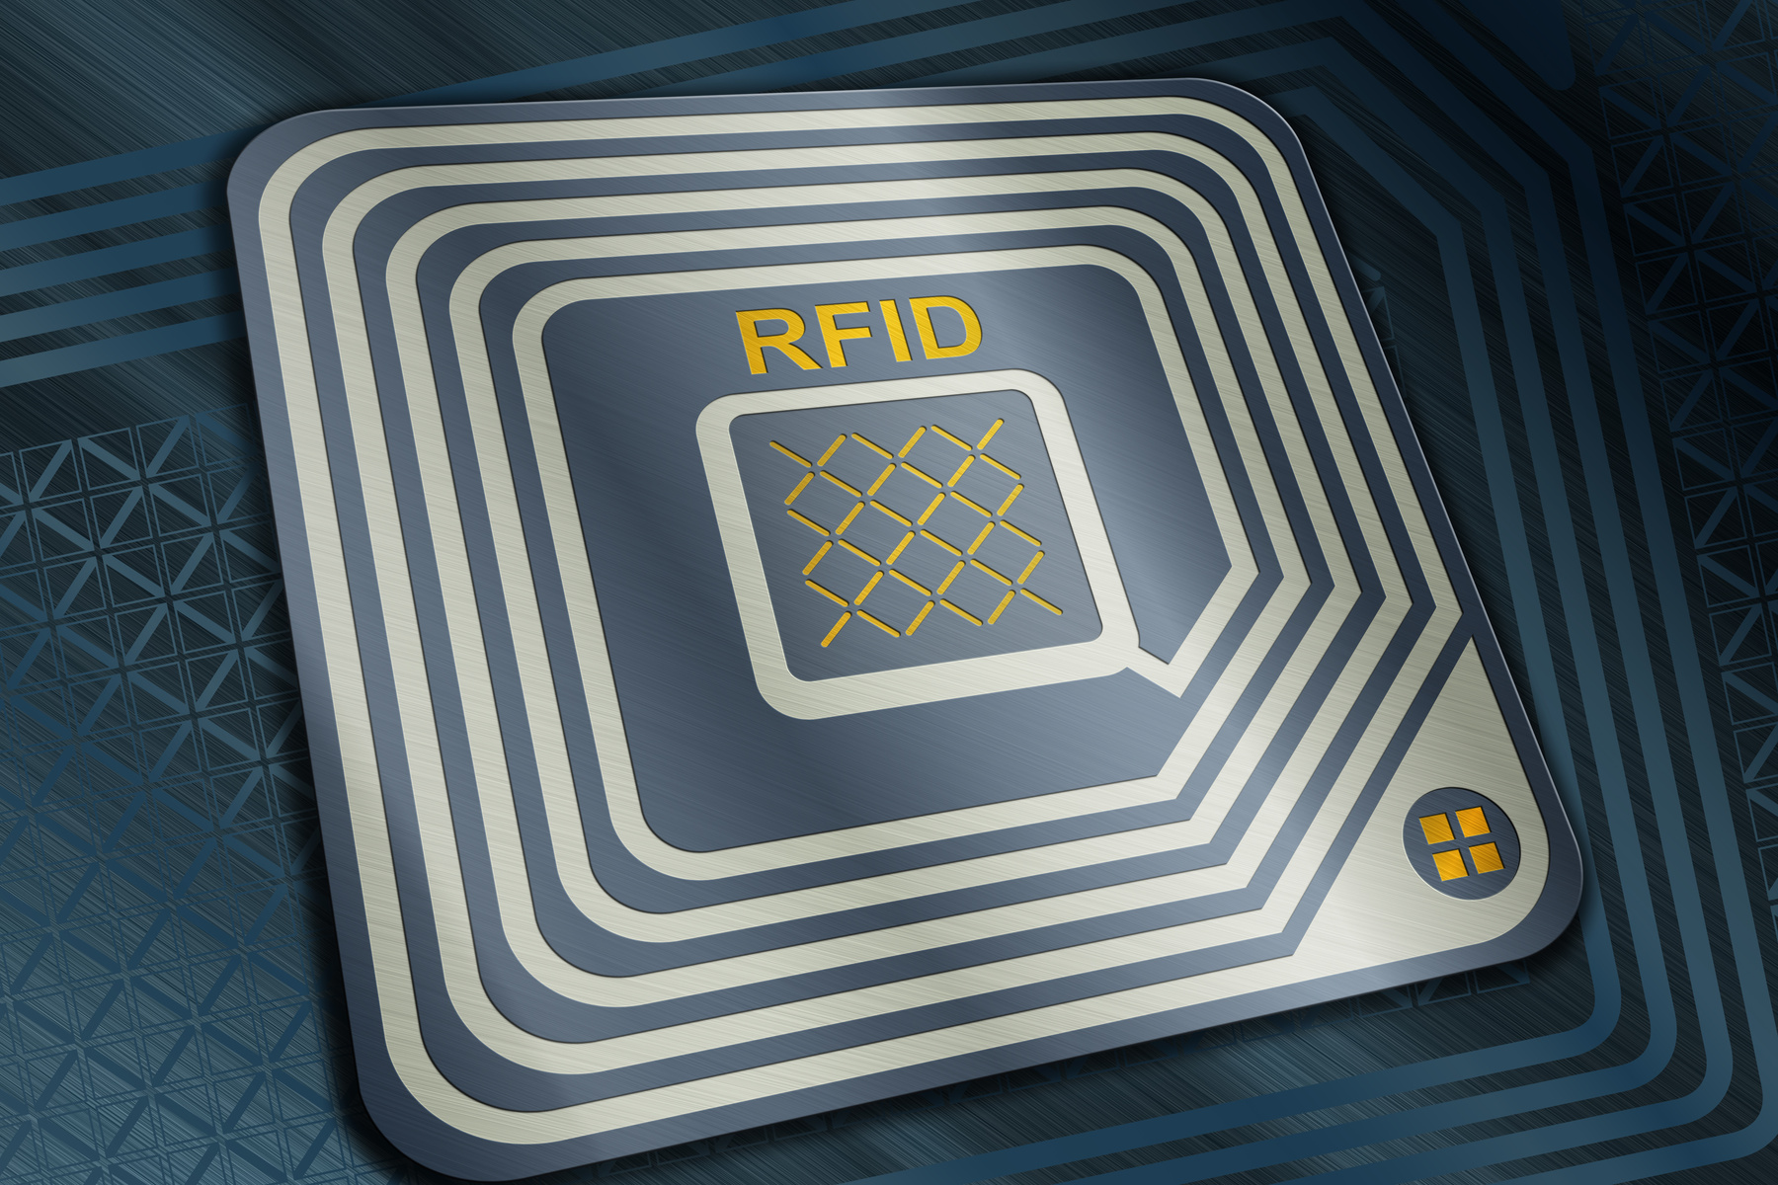





WHY UFH RFID?
Fast
Trustworthy
Correct
Economic
New Technology

Slide 6
WHAT IS LIBREF?
  150 Libraries, Archives and Museums in Turkey, the Middle East and Europe
  95% Market Share by Number of Materials
  85% Market Share by Number of Customers
  30,000,000 Labeled Material

Slide 7


WHY LIBREF?
Low Hardware and Software Costs
Low Cost
Integration capability and supplier independence
Integration
Data security, capacity that can be easily increased
Security

Slide 8

MODULES
01
Matching Module
02
Borrowing and Return Module
03
Security Gate Module
04
Self-Check Module
05
Counting Module
06
Reporting Module

Slide 9





HARDWARE COMPONENTS
Software
Loaner / Return Kit
Kendi Kendine Kontrol
Book Label
Security Gate
Hand Terminal

Slide 10
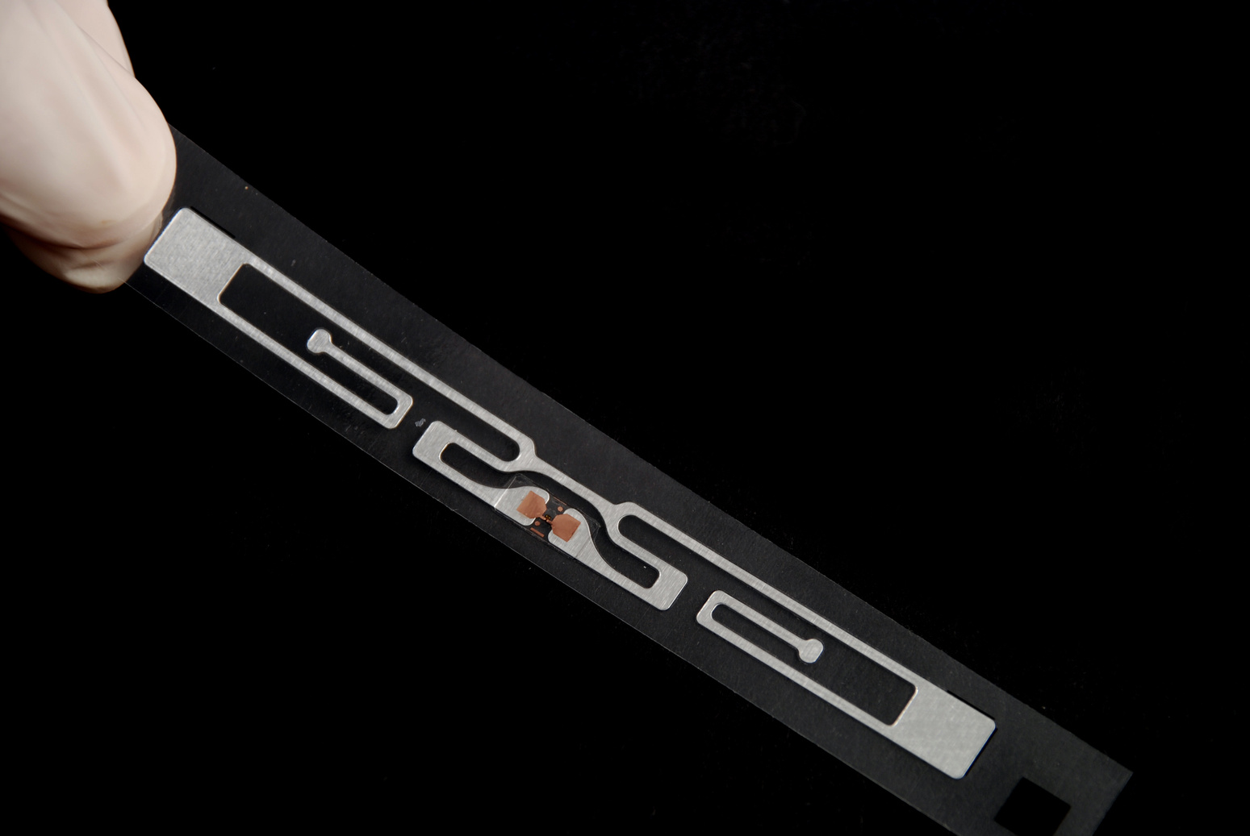
BOOK LABEL
  Concealable
  Double side adhesive
  2m - 4m reading distance
  Special antenna design

Slide 11

MATCHING MODULE
  RFID Tag Matching
  RFID Label Cleaning
  RFID Tag Killing

Slide 12

BORROW-RETURN MODULE
  Original design
  Ability to read only the materials in the hopper thanks to linear reading
  Ability to read up to 10 materials
  Ability to take fast and accurate action
  Label and material matching

Slide 13
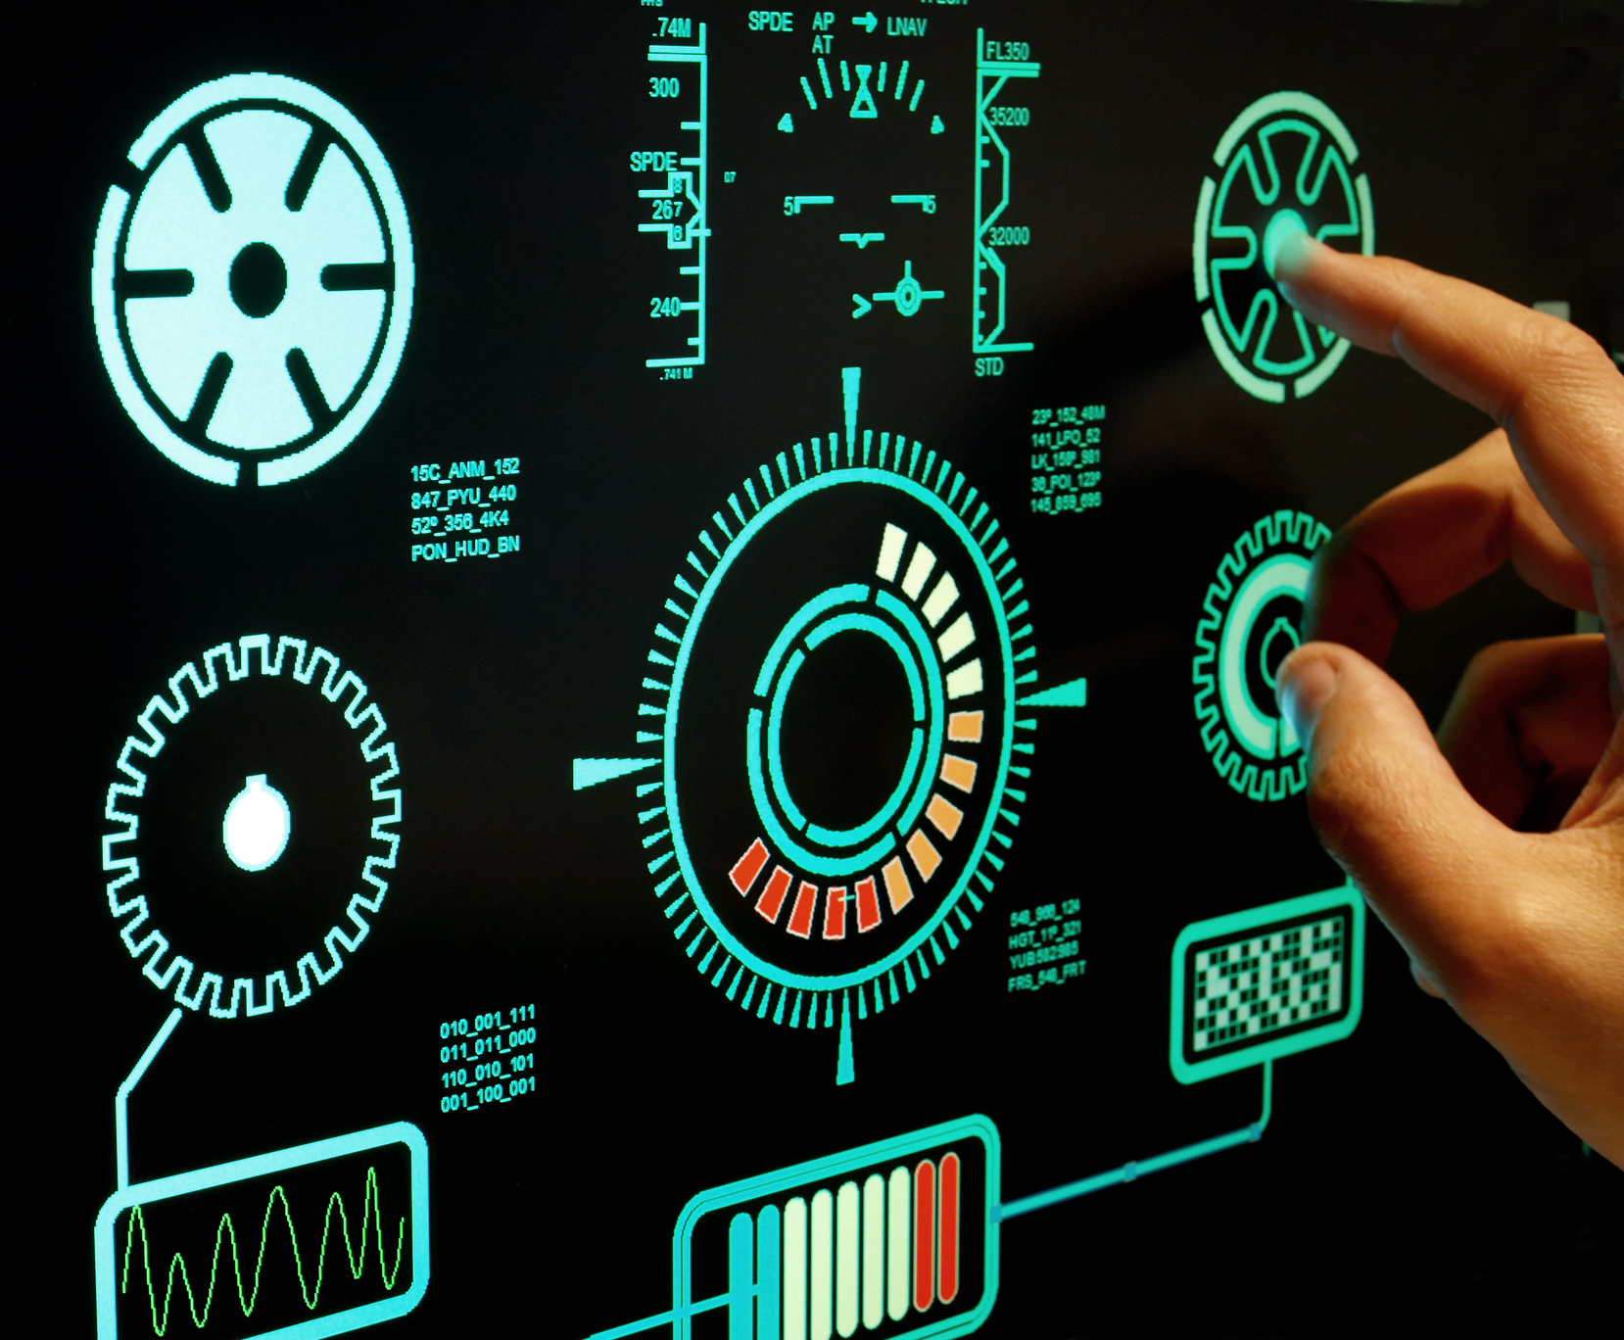

SECURITY GATE
  People Counting Sensor
  Library usage statistics
  Monitoring of authorized / unauthorized material outputs
  Offline operation mode
  Possibility to print the library logo
  Impact-resistant construction, stylish design
  Detect on-chip security bits
  Floor mountable feature
  Detect material with more than one label attached
  Sound and light warning system

Slide 14
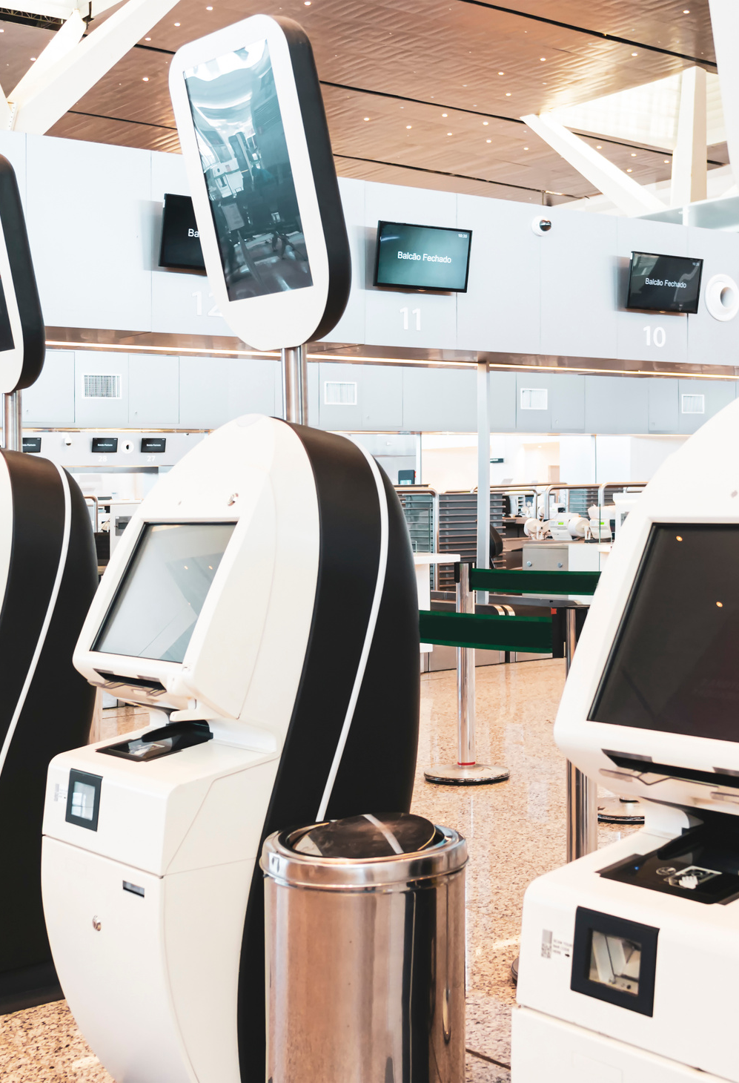
SELF-CHECK MODULE
  100% reliability, easy to use
  Fast integration and plug-and-play
  Multi-language option
  Multiple loans/refunds with UHF RFID feature
  Automatic user recognition
  Remote management support
  Usage statistics
  Touch screen, Anti-bacterial film

Slide 15
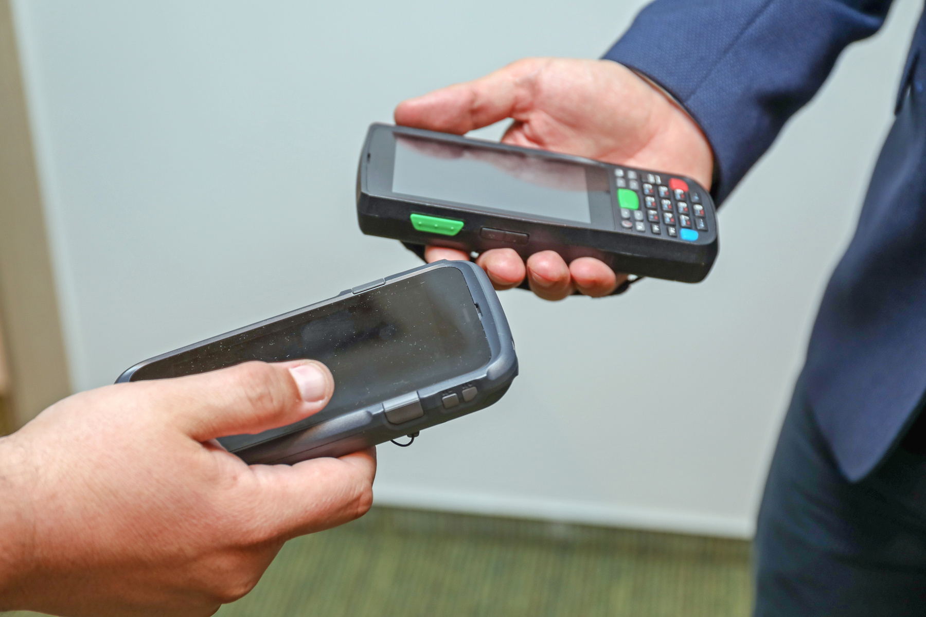
HAND TERMINAL
  Census
  Search / Find
  Shelf Control

Slide 16
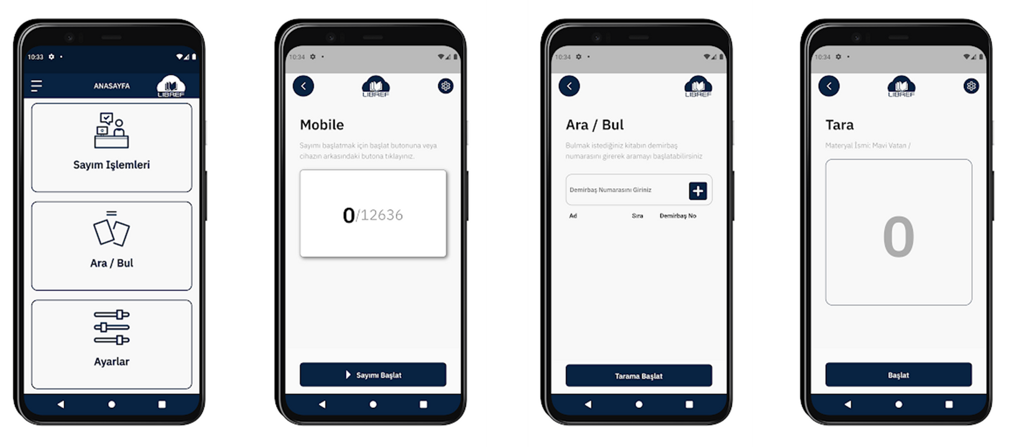
COUNTING MODULE

Slide 17

REPORTING MODULE
  Title, place number, inventory number, location and collection information of crypts matched by unit,
  Door material transition report,
  Census report

Slide 18
Thanks For Listening

